Slide 1
Management Information Systems
Chapter 1
Introduction

Slide 2
Outline
How can MIS help you in your job?
What is MIS?
Why is information technology important? Why do all business majors need to study it?
What are e-commerce and e-business? Is e-business increasing or decreasing?
Do you know what a manager does? Do you know what a successful manager will do in the future?
How is business changing? What will managers need to know in the future?
Does technology alone improve a business?
How do you break businesses into smaller pieces to analyze them?
Why are strategic decisions so difficult? How do you begin searching for competitive advantage?

Slide 3
What is MIS?
Information
Data that has been put into a meaningful and useful context. Usually to help make a decision.
Management Information System
A combination of computers and people that is used to provide information to aid in making decisions and managing a firm.
Information Technology (IT)

Slide 4

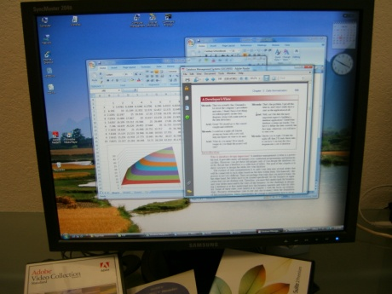

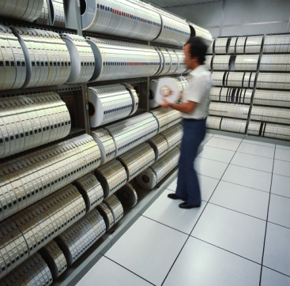
MIS Components
Hardware
Software
Backup data
Restart job
Virus scan
People
Data
Procedures

Slide 5
Goal of This Course
How can MIS help you do your job?
Understand the technology.
Analyze business problems.
An introduction to systems analysis.
Identify types of problems that MIS can help solve through cases.
Ability to classify problems.
Know when to call for help.

Slide 6
Why is MIS Important?
MIS affects all areas of business
Manufacturing
Accounting & Finance
Human resources
Marketing
Top management
Performance evaluations—expectations

Slide 7
Chapters/Topics
Introduction
Technology Foundations
Networks
Databases
Security
Transactions and ERP
eCommerce
Teamwork
Decisions
Strategy
Entrepreneurship
Systems
MIS Organization
Society

Slide 8
Productivity Growth: Output per Worker
Managers need to use technology to increase productivity to be competitive.
With a 2.9% growth rate, in a decade, productivity increases 34%. Companies can produce the same output with half the workers. Will you be one of the workers replaced?
http://data.bls.gov:8080/PDQ/outside.jsp?survey=pr

Slide 9
What are e-Commerce and e-Business?
Business-to-Consumer (B2C)
Selling retail products to consumers
Business-to-Business (B2B)
Selling at the wholesale level to other businesses
E-Business
Using Internet technologies to conduct any level of business
E-Commerce
Intranets
Most areas of MIS

Slide 10
Retail E-Commerce Statistics
In 2010 EC was about 5 percent of total.
Remove autos and auto parts and EC is about 6 percent.
Notice the seasonal peak in the fourth quarter.
Notice the EC is growing faster than total retail sales.
http://www.census.gov/retail/index.html#ecommerce

Slide 11
Technology Excesses?
You can buy a new model item when it is released or wait for the price to drop.
You can keep buying new releases or continue to use an “old” model.
Answers depend on your needs, the features offered, and the reliability of the old items.
Plus the bling factor.

Slide 12
What do Managers do?
Traditional
Organizing
Planning
Control
Mintzberg
Interpersonal
Informational
Decisional
Luthans
Traditional 50%
Formal Communication 30%
Networking 20%

Slide 13
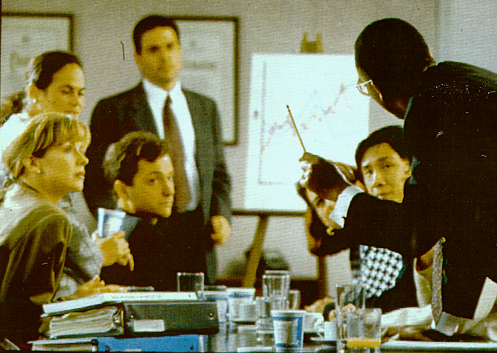
Meetings
Managers and professionals spend considerable time in meetings. Providing
support for teamwork and group decisions is an important issues in MIS.

Slide 14
Making Decisions
Methodology v Ad Hoc Decisions
Decision Process
Collect Data
Identify Problems & Opportunities
Make Choices
2
3
1

Slide 15
Traditional Management
CEO
Condensed reports
Commands
VP
Finance
VP
Marketing
VP
Accounting
VP
HRM
VP
MIS
Analyze data
Layers of middle managers
Collect
data
Customers

Slide 16
Decentralization
Management Team
CEO
VP
Fin
VP
Mrkt
VP
Acct
VP
HRM
VP
MIS
Strategy
Finance
Team
Marketing
Team
Accounting
Team
HRM
Team
Corporate
Database
&
Network
Sales
Team
Methodology/Rules
Franchise
Customers

Slide 17
Business Trends
Changing business environment
Specialization
Management by Methodology and Franchises
Mergers
Decentralization and Small Business
Temporary Workers
Internationalization
Service-Oriented Business
Re-engineering
Need for faster responses and flexibility

Slide 18
Business Trends & Implications
Specialization
Increased demand for technical skills
Specialized MIS tools
Increased communication
Emphasis on Teamwork
Methodology & Franchises
Reduction of middle management
Increased data sharing
Increased analysis by top management
Computer support for rules
Re-engineering
Mergers
Larger companies
Need for control and information
Economies of scale
Decentralization & Small Business
Communication needs
Lower cost of management tasks
Low maintenance technology

Slide 19
Business Trend Summary
Business Trend | Implications for Technology
Specialization | Increased demand for technical skills Specialized MIS tools Increased communication
Methodology & Franchises | Reduction of middle management Increased data sharing Increased analysis by top management Computer support for rules Re-engineering
Mergers | Four or five big firms dominate most industries Need for communication Strategic ties to customers and suppliers
Decentralization & Small Business | Communication needs Lower cost of management tasks Low maintenance technology
Temporary Workers | Managing through rules Finding and evaluating workers Coordination and control Personal advancement through technology Security
Internationalization | Communication Product design System development and programming Sales and marketing
Service Orientation | Management jobs are information jobs Customer service requires better information Speed

Slide 20
Business Trends & Implications
Temporary Workers
Managing through rules
Finding and evaluating workers
Coordination and control
Personal advancement through technology
Security
Internationalization
Communication
Product design
System development and programming
Sales and marketing
Service Orientation
Management jobs are information jobs
Customer service requires better information
Speed

Slide 21
Internationalization
http://www.bea.gov/national/nipaweb/Index.asp

Slide 22
International Web Browsers
http://www.internetworldstats.com/stats7.htm

Slide 23
Web Users (Counts)
Asia: 30 percent of population
North America: 75 percent
http://www.internetworldstats.com/stats.htm

Slide 24
US Employment Patterns
Categories and definitions have changed over time.
Management includes professional, sales, and administrative.
The key point is that most jobs are information-processing jobs.
But the numbers measure number of workers, not the value or sales.
http://www.bls.gov/webapps/legacy/cpsatab4.htm

Slide 25
Changing Business Environment
US History: Farmer Laborer Management
Year | Farm | Mfg | Mgt | Service
1920 | 29% | 44% | 22% | 6%
1940 | 23 | 38 | 30 | 8
1960 | 9 | 36 | 43 | 12
1980 | 3 | 32 | 52 | 13
2000 | 1 | 16 | 66 | 17
2010 | 1 | 11 | 68 | 20

Slide 26
MIS Organization
EIS
Strategic
Mgt.
ERP
ES
Tactical
DSS
Management
Transaction
Process Control
Business Operations

Slide 27
Operations, Tactics,Strategy

Slide 28
Decision Levels
Decision Level | Description | Example | Type of Information
Strategic | Competitive advantage, become a market leader. Long-term outlook. | New product that will change the industry. | External events, rivals, sales, costs quality, trends.
Tactical | Improving operations without restructuring the company. | New tools to cut costs or improve efficiency. | Expenses, schedules, sales, models, forecasts.
Operations | Day-to-day actions to keep the company functioning. | Scheduling employees, ordering supplies. | Transactions, accounting, human resource management, inventory.

Slide 29
Introduction to Strategy
Risk & Reward
Creativity
Porter’s External Agents
Customers
Suppliers
Competitors
Government

Slide 30
Strategy/Porter
Threat of
New Entrants
Bargaining Power
of Suppliers
Rivalry Among
Existing Competitors
Bargaining Power
of Buyers
Threat of Substitute
Products or Services

Slide 31
Baxter/Strategy
Typical Supply Relationship
Supplier
Hospital
American Hospital
Supply
Warehouse
Supply
Closets
Supplier
Supply storeroom
Supplier

Slide 32
Baxter/Strategy
AHS/Baxter Computer Link
Supplier
Baxter
Hospital
American Hospital
Monitor
Usage data
Supply
Warehouse
Supply Closets
Computer
Deliver
Supplies as
needed
Supplier
Free space
Accurate usage data
Supplier

Slide 33
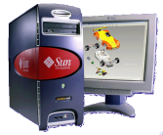

An Internet Approach for Hospital Supply
Daily Auction
Bid1
Bid2
Bid3 <<purchase
Supplier
Baxter
Hospital
Supply Closets
Internet
Supplier
Johnson
Winning bidder delivers supplies
Supplier

Slide 34
Strategy/Organization
Strength
Source of strength
Value of strength
How can it be developed?
What could undermine it?
Development costs
Additional benefits (opportunities)
Weaknesses
Effect on company
Possible solutions
Cost of solution
Result and cost of leaving as-is (do nothing)

Slide 35
Cloud Computing
As consumers and students, you are familiar with Web-based services.
E-commerce, sales
News, entertainment
Communications
Social networks and interaction
Businesses can use the same approaches and run software and data on Web servers with applications on laptops, tablets, and cell phones to access this data.
Cloud computing consists of running the main servers, data, and business logic on Web-based servers in the Internet cloud.
Each chapter explores impacts and implications for business of moving more operations into a Web-based system.

Slide 36
Technology Toolbox: Choosing a Search Engine
General purpose search engines
Google, Bing, Yahoo
Meta-searches across multiple engines
Dogpile
Encyclopedia
Wikipedia.org
Dictionary
Wiktionary.org (or click the research button in IE)
Phone book
Switchboard, Superpages
Products
Mysimon, Cnet
Government data
CIA.gov (World Factbook)
Fedstats.gov (main data source)
SEC.gov (EDGAR corporate filings)
Math and Science and some Data
Wolframalpha
Consider using multiple search engines because some of them filter responses based on your prior queries.
Other (and often better)
Your library databases

Slide 37
Cases: Fast Food Industry

